Slide 1
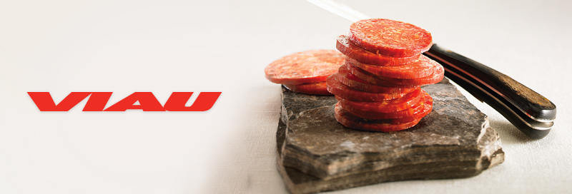
Between Tradition and Modernism
Established in 1977, Viau offers a vast array of first choice products, featuring cooked or dry cured pepperoni, Italian cooked meats, sausages, pizza toppings and meatballs.
Viau built its strong reputation on innovation, given the fact that the company was the first to develop, produce and market a dry cured pepperoni in Canada.
Today, Viau is proud to be Canada’s most important independent producer of pepperoni. It is an HACCP-accredited and a USDA-recognized company.
Our values? Quality and authenticity, fidelity and tradition. Welcome to a company with an excellence-based reputation.

Slide 2
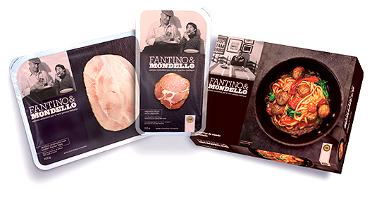
SILA & VIAU cater to the Food Industry Professionals. FANTINO & MONDELLO is a Consumer’s Delight.
SILA is the brand dedicated to supplying hotels, restaurants and the food processing industry. It stands out for its freshness, its unique blend of meat and seasonings which includes cooked and dry cured pepperoni, meatballs and a line of pizza toppings.
FANTINO & MONDELLO is our consumer-targeted home brand of cooked specialty deli products. It brings authenticity and taste to true Italian classics.
VIAU is the original brand combining skillfully blended pork, beef and seasonings. This cooked pepperoni remains true to its authentic and traditional recipe.

Slide 3
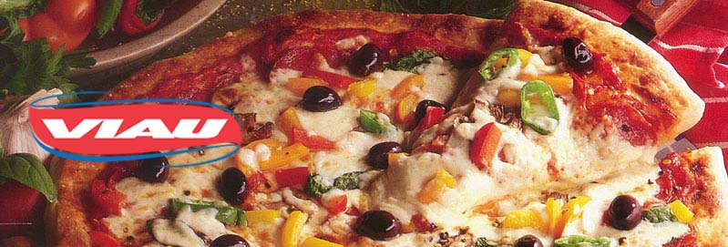
Innovative. Genuine. The brand which began it all.
Our cooked pepperoni combines a skillful blend of pork and beef with traditional seasonings to create tastes that are truly refined. In choosing our Viau brand, you will benefit from our efficient, modern production techniques that remain faithful to traditional recipes. Available in a variety of sizes and formats, our cooked pepperoni will be the key to the success of your Italian recipes.
Viau Foods’ cooked pepperoni. Hooked on tradition.

Slide 4
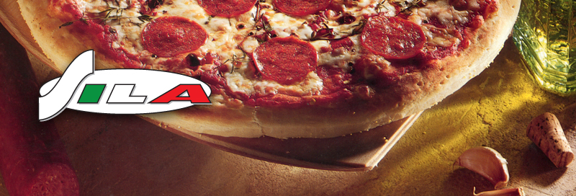
The Brand of Freshness and Flavor
Sila believes in traditional values. You can feel it, smell it and taste it! Sila pepperoni for instance, is patiently cured and dried. Sila meatballs are made with old world ingredients and spices “just like mama used to make”, and Sila pizza toppings can turn an ordinary pizza into a culinary delight!
With Sila’s unique blend of ingredients and high standards, you are guaranteed a perfect recipe every time.
Pepperoni, Meatballs and Pizza Toppings by Sila. Success at your counter!

Slide 5
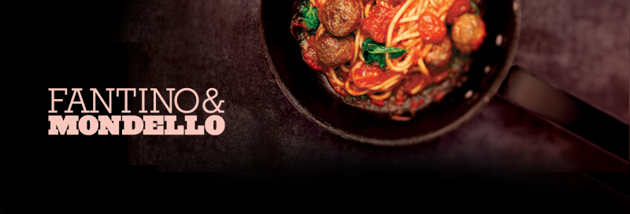
The Brand of Authenticity and Taste… the Italian Way!
For over 50 years, Fantino & Mondello has been making history thanks to its ancestral traditions and typical recipes from Italy, offering true Italian cooked deli meats with an ever-growing reputation for outstanding quality.
Since 1949, this family-owned company knows the importance of quality and customer service. Put together traditional seasoning, mix it with cutting-edge production techniques, and voilà! Out of the ordinary meals begin with Fantino & Mondello.

Slide 6
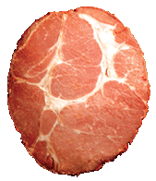
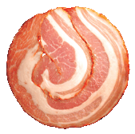
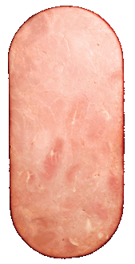
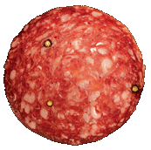
Capicollo
Pancetta
Mortadella
Cooked Pepperoni
Dry Pepperoni
Pizza Toppers
Meatballs
Sausage

Slide 7
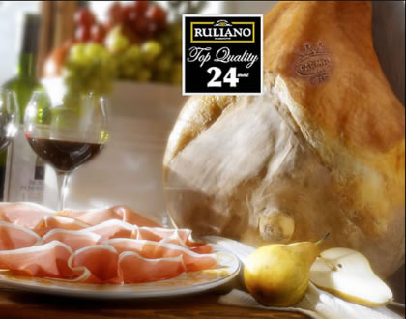
RULIANO Top Quality ®
HAMS AREN'T ALL THE SAME
Hams are like champagne: each maison, each cellar, has its peculiarity. They’re all called champagne, but each one is different from all the others! For hams too, you always have to identify the maker and the brand, because each producer has its own processing system that decisively impacts the quality of the product. This is the reason why HAMS AREN’T ALL THE SAME. Ruliano Top Quality selects only the best hams from Italian pigs born and raised in the heart of the Po Valley. Next comes processing according to rules consolidated over three generations. The ham factory is equipped with the latest in modern technology to enable careful and strict controls in all processing stages. Just a little salt, the most ancient way to preserve food in a natural way, without any preservatives or additives. The air of our mountains contributes to create the unique microclimate ideal for curing Ruliano Top Quality hams. The natural and genuine characteristics of Ruliano Top Quality hams are the important elements that distinguish us, that we’ve always strived for. The fat of Ruliano Top Quality hams contains polyunsaturated fatty acids, characteristic of vegetal fats and also present in extra virgin olive oil, that are important regulators for the synthesis of cholesterol and triglycerides. Therefore the lipid component – the fat – doesn’t represent a health risk. The Ruliano Top Quality ham is an extraordinary product for any diet: it’s good, and suited to any moment of the day: breakfast, lunch, an afternoon snack, dinner. What’s more, it’s practical, ready to eat, lean, and healthy! Sweetness, flavour and taste blend together to create the true Ruliano Top Quality ham. Hams are an outstanding Italian product that is envied world-wide. That’s why Ruliano Top Quality wants to be the best guarantee of quality. So remember, always be extra careful to identify the brand of hams, because HAMS AREN’T ALL THE SAME!

Slide 8
Quality Matters Beyond our Products. It is the Cornerstone of our Business Relationships.
We will gladly answer all your questions about the products. For samples please feel free to contact us at your convenience.
Robert Klaczyk 716.684.5470
Bill Wright 609.638.0066
Brian Lesniowski 716.574.7449
Chef Michael Morrison 561.747.0504

